Slide 1
EFFECTS OF ALTITUDE ON HUMANS
GROUP 21

Slide 2
GROUP MEMBERS
Adumoah Samuel – 4435618
Anto Ebenezer – 4439818
Owusu Afriyie Nana Frema – 4456018
Lomotey Lomoteley Doreen – 4450918
Antwi Anyeniwaa Elizabeth – 4439918
Gyeni Judith – 4449118
Opoku-Bamfoh Obadiah – 4463918
Twum-Mensah Phebe Ewura Akua – 4459118
Appiah Boahen Edmund - 4440618

Slide 3
OUTLINE
Introduction
Effects Of High Altitude On Humans
Effects Of Low Altitude On Humans
How altitude affects the human body
Conclusion

Slide 4
Introduction
Altitude is a distance measurement, referring to the distance above sea level of a location.
The Earth’s atmosphere is divided into several altitude regions.
Some examples of altitudes include troposphere, stratosphere, mesosphere, thermosphere and exosphere.

Slide 5
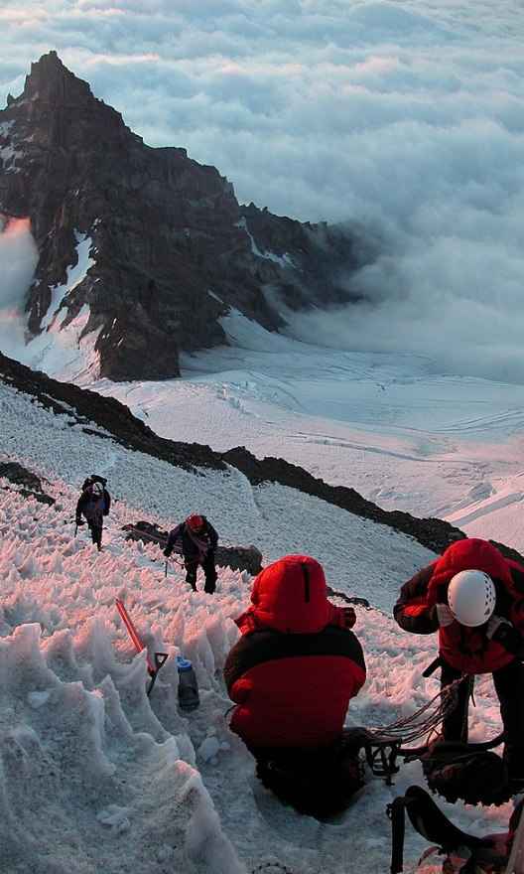
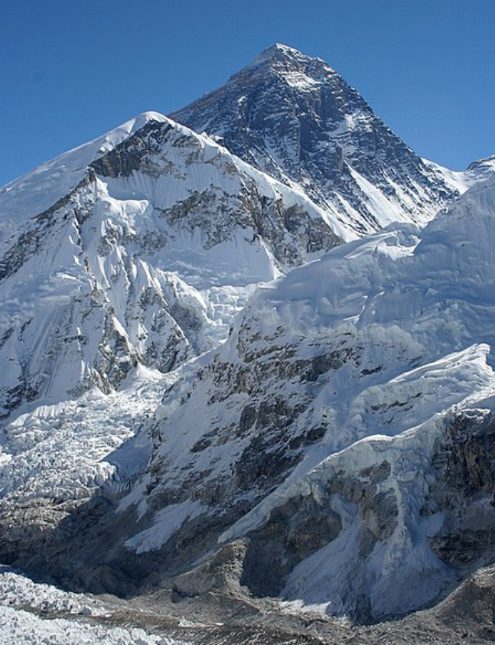
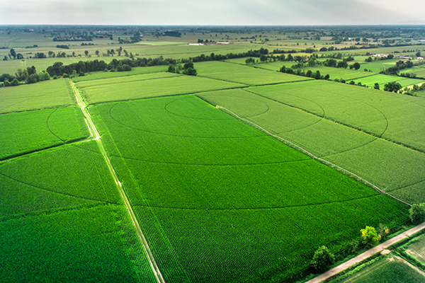
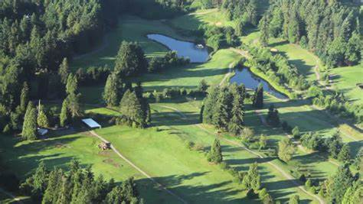

Slide 6
HIGH ALTITUDE
High Altitude refers to regions on the Earth’s surface or in the atmosphere that are high above mean sea level.
High altitude is sometimes defined to begin at 2400 meters (8000 ft) above sea level.
These areas are characterized by low atmospheric pressure, low moisture and high wind speeds.

Slide 7
LOW ALTITUDE
Low Altitude refers to refers to any elevation equal to or less than 1,219 meters (4,000 feet).
The lowest land area is the shoreline of the Dead Sea Depression in Israel, Jordan and Syria.
These areas are characterized by high atmospheric pressure, high oxygen concentration, increased humidity, etc.

Slide 8
How does the change in altitude affect the body?
At high altitudes, oxygen molecules are further apart because there is less pressure to “push” them together. This effectively means fewer oxygen molecules in the same air volume as we inhale. In scientific studies, this is often referred to as “hypoxia”.
However, the human body has both short-term and long-term adaptations to altitude that allows it to partially compensate for the lack of oxygen.

Slide 9
How does the change in altitude affect the body?
The lungs play a crucial role as it acts as an interface between the environment and the functions of the body by supplying oxygen. The body automatically takes compensatory measures( the process of acclimatization) to overcome the thin air.
This causes acute mountain sickness (AMS) which is accompanied by headache, gastrointestinal problems, and sleep disturbance.. Fluid starts building up in the lungs. The breathing rate also increases, even at rest.

Slide 10
How does the change in altitude affect the body?
The blood tries to increase the amount of circulated haemoglobin. However, excess haemoglobin in the blood can result in severe clotting.
The first exposure to altitude causes nausea, vomiting, headache, insomnia, fatigue, and dizziness. The condition gets worse when a person develops High-Altitude Cerebral edema(HACE), The lack of oxygen damages the brain cells.

Slide 11
How does the change in altitude affect the body?
Kidney diseases progress faster at high altitude which can lead to renal hypoxia and renal injury. There is an increase in the frequency of urination as the body tries to get rid of excess fluids. But the urine output and sodium excretion depend on the partial pressure.
Cardiovascular system gets affected at high altitudes since the level of oxygen in blood decreases. This causes the heart to pump faster, increases adrenaline release and pulmonary artery pressures. Patients suffering from cardiac issues should avoid places of thin air as they are prone to heart attacks.

Slide 12
EFFECTS OF HIGH ALTITUDE ON HUMANS
Hypoxemia
Increased breathing at high altitudes
High production of red blood cells
Increase in water loss
Loss of appetite

Slide 13
EFFECTS OF LOW ALTITUDE ON HUMANS
Less breathe intake
Increased hydration
Decreased metabolism
Increased perspiration

Slide 14
CONCLUSION
The effects of altitude on humans has considerably caused the human body to learn to adapt and compensate when necessary for its survival.

Slide 15
Thank you
QUESTIONS

